Slide 1
Week 8 Lab: Modern Analog Technique
Brittany Hupp
Lab 8 Plots

Slide 2
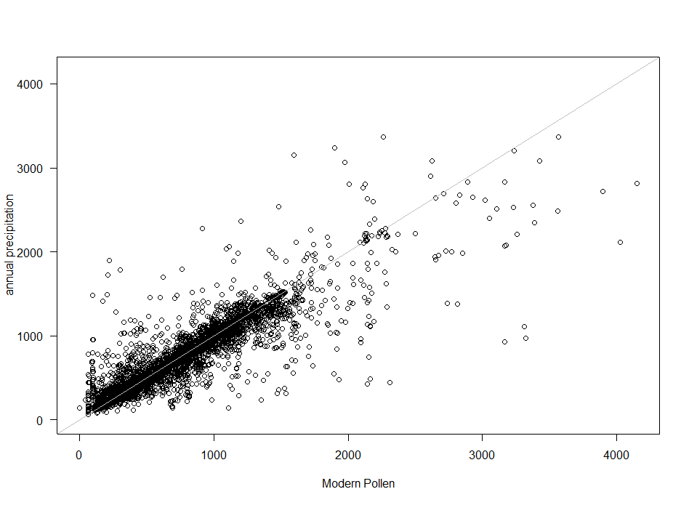
Correlation: Modern Pollen vs. Annual Precipitation

Slide 3
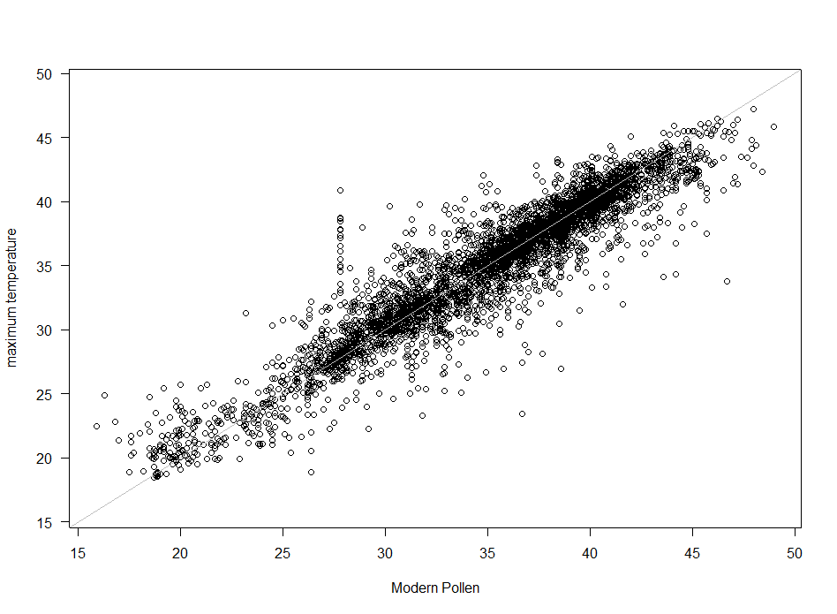
Correlation: Modern Pollen vs. Maximum Temperature

Slide 4
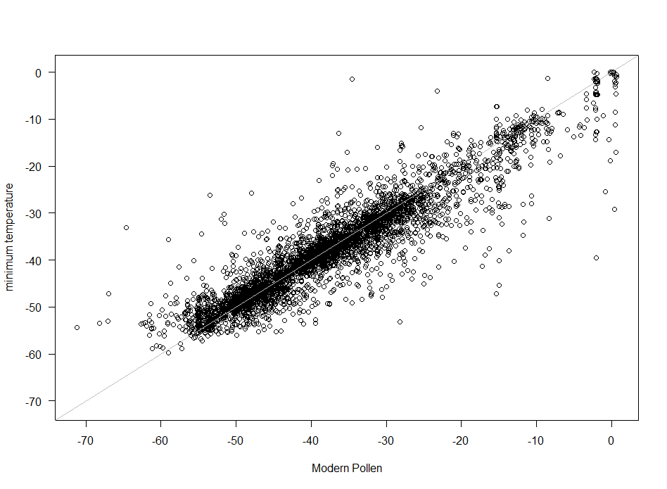
Correlation: Modern Pollen vs. Minimum Temperature

Slide 5

Cross Validation: Modern Pollen vs. Annual Precipitation

Slide 6

Cross Validation: Modern Pollen vs. Maximum Temperature

Slide 7
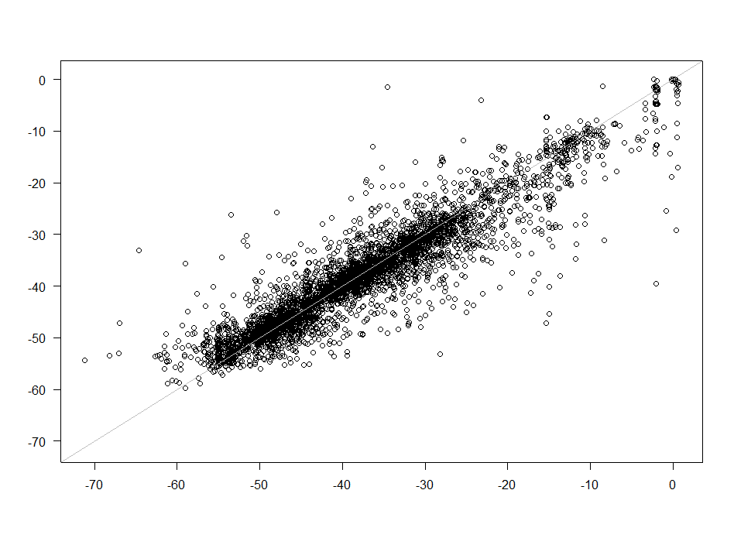
Cross Validation: Modern Pollen vs. Minimum Temperature

Slide 8
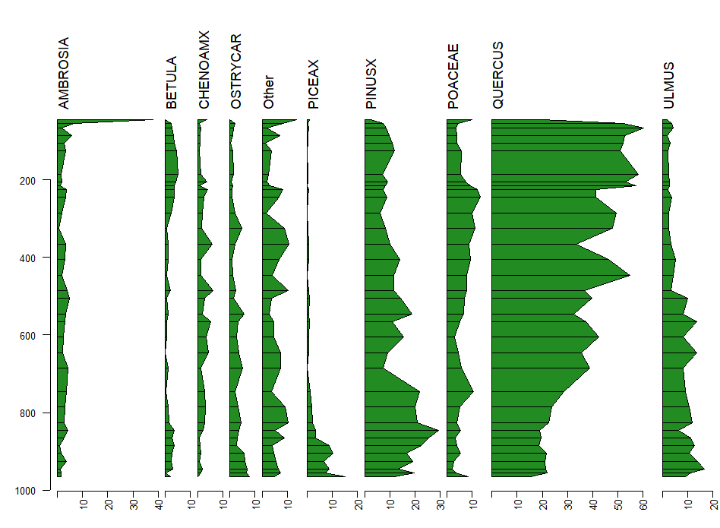
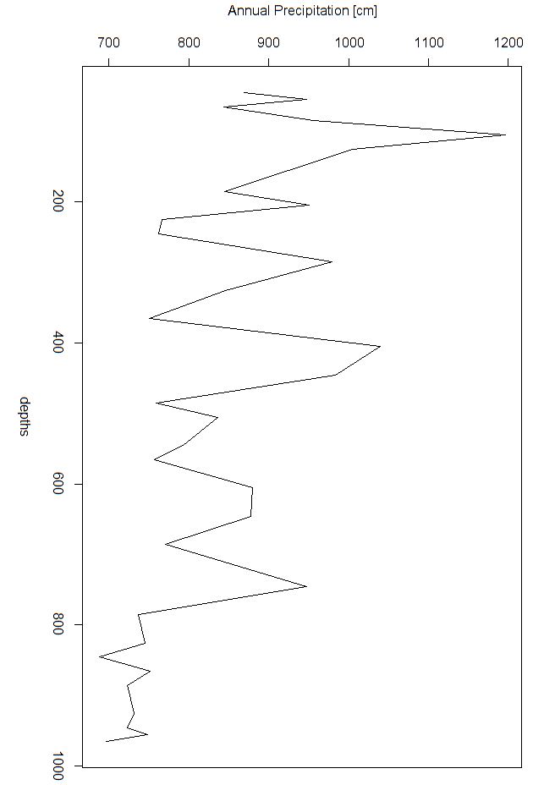
Mendota D Pollen vs. Predicted Environmental Variables Annual Precipitation

Slide 9
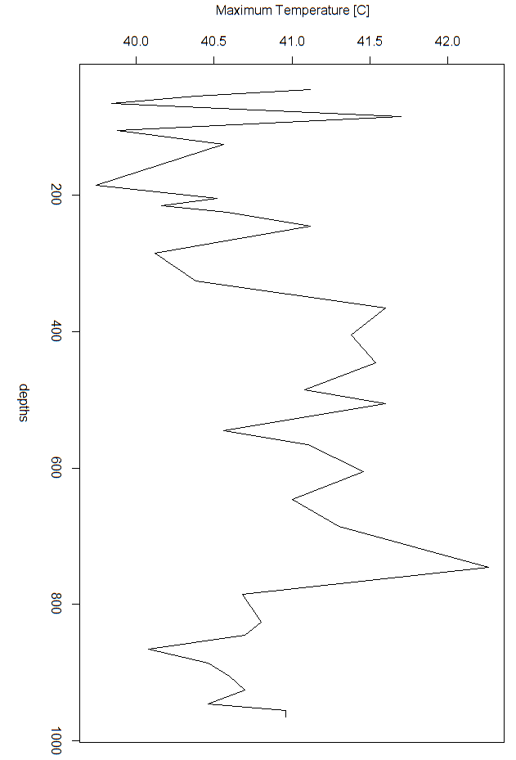
Mendota D Pollen vs. Predicted Environmental Variables Maximum Temperature

Slide 10
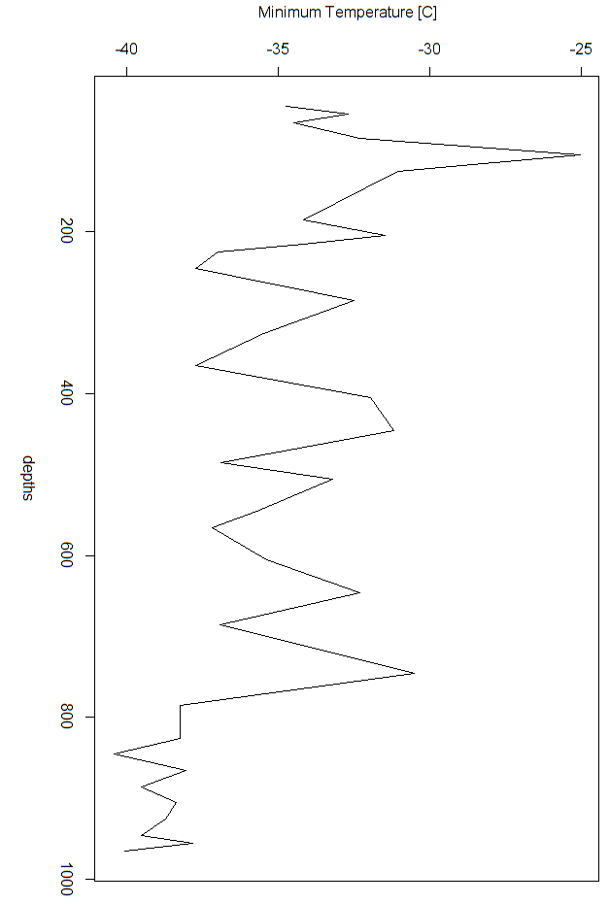
Mendota D Pollen vs. Predicted Environmental Variables Minimum Temperature

